Slide 1
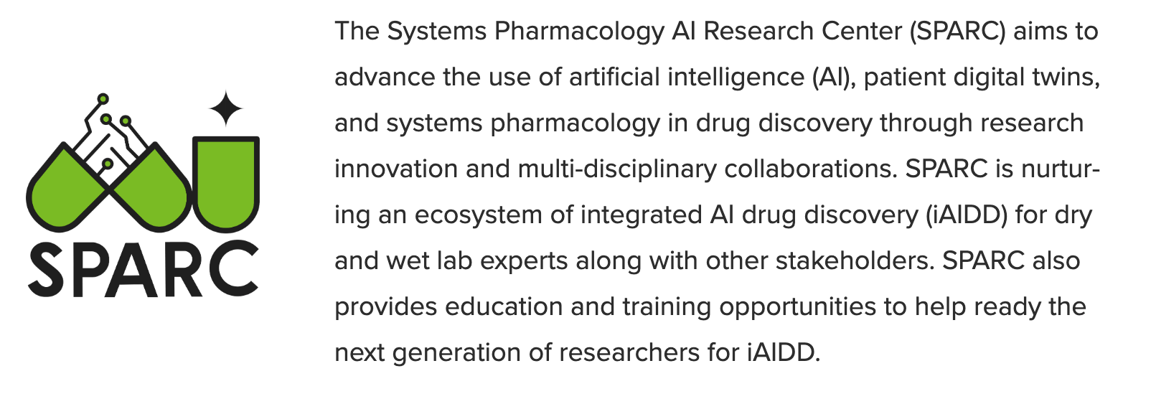
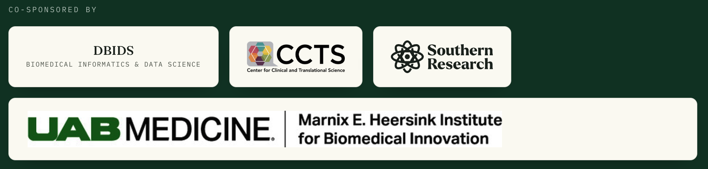
2026 SPARC Drug Discovery CollaboFest
Who are we?

Slide 2

The CollaboFest Opportunity
3
$40K
$1K
3 Pages
Sept 30
Teams
Selected
Combined
In-Kind Services
Cash Prize
Per Team
Proposal
Length
Submission
Deadline
Award Structure
Core Eligibility
Combined SPARC AI design and Southern Research wet-lab service credits. These are commitments of staff expertise and supercomputing, not a cash grant. The final work breakdown is jointly defined with winning teams.
At least one co-investigator must be affiliated with UAB or the CCTS Partner Network. Additional team members are welcome from any academic or clinical institution. Interdisciplinary structures are strongly encouraged.
2026collabofest.ubrite.org

Slide 3
Building Durable, Fundable Research Partnerships
01 Sharper Question
02 Meet Collaborators
03 Stress-Test Readiness
04 Grant-Ready Package
Transform a broad research goal into a single, decision-driven therapeutic hypothesis.
Connect wet-lab, clinical, data, and chemistry leads across the UAB-led CCTS network.
Evaluate data access permissions, assay feasibility, and validation ownership early.
Walk away with preliminary figures and structured rationale for NIH/DoD grants.
Core Philosophy: CollaboFest is not a service relationship. It is an engine explicitly designed to connect domain experts with SPARC AI and drug discovery experts to create durable research teams.

Slide 4
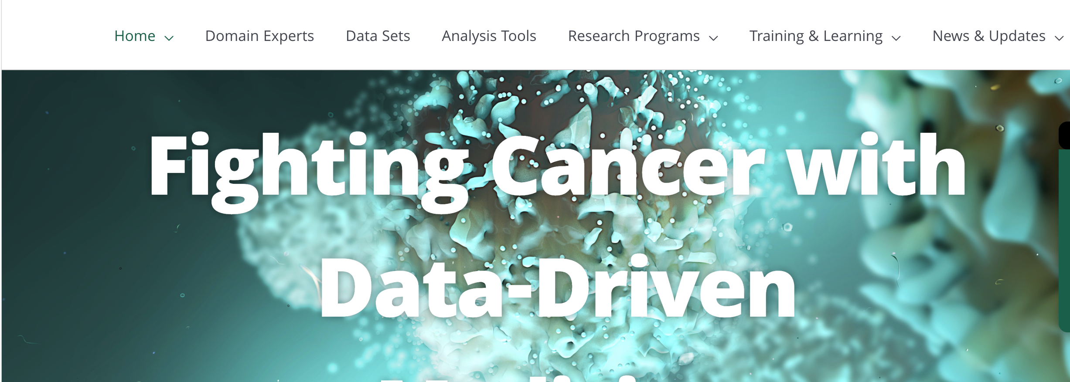
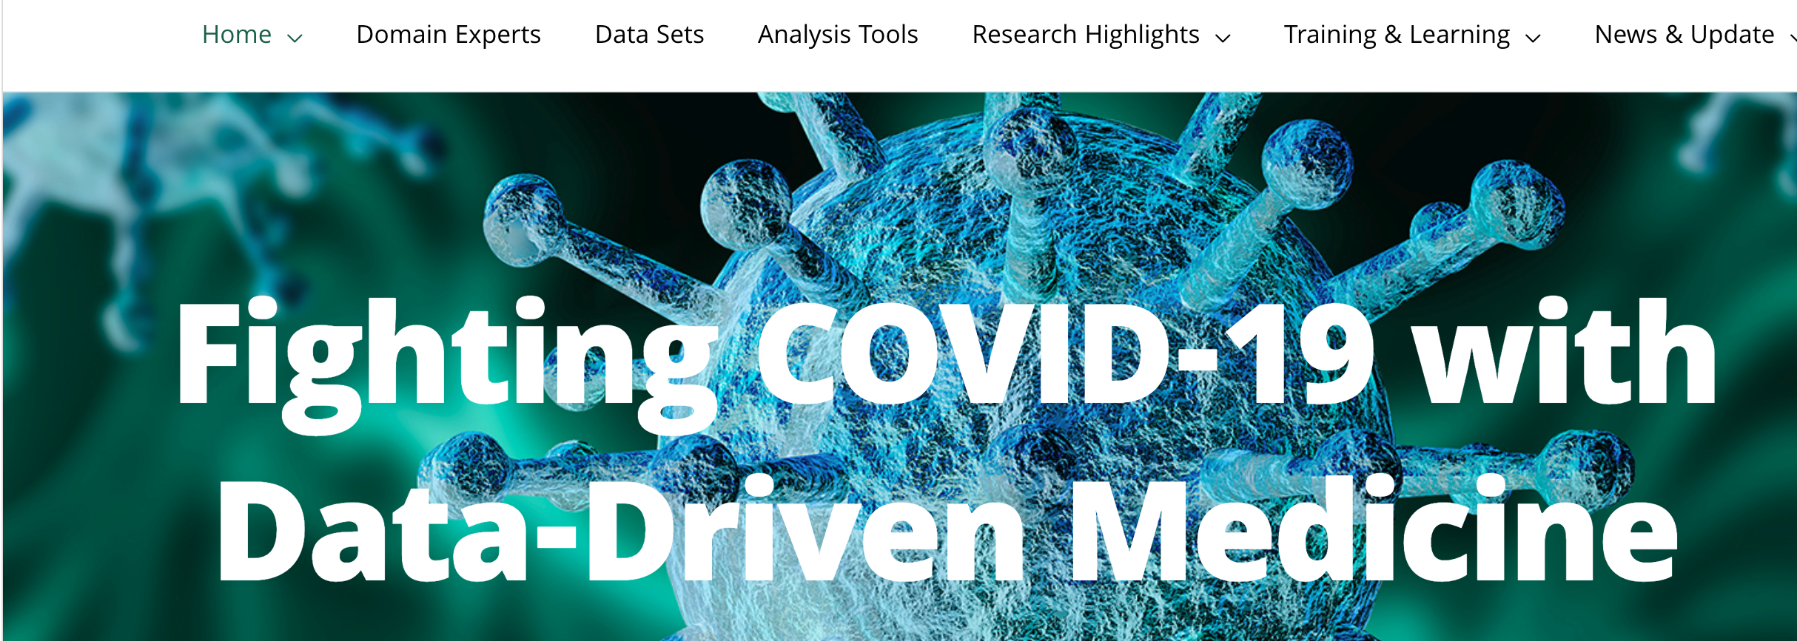
Our past experience empowering communities with AI and data science skills
Covid19.ubrite.org
Cancer.ubrite.org

Slide 5
Three Scientific Pillars
Targets
(Discover what to treat)
Chemicals
(Design what to give)
Patient Cohorts
(Design who & how)
The Core Process
The Core Process
The Core Process
Mechanism → Target → Biomarker
Screen → Generate → Optimize
Phenotype → Enrich → Simulate
Potential Services
Potential Services
Potential Services
Multi-omics integration, causal systems-pharmacology modeling, competitive assessment.
Virtual screening, generative chemical design, binding-mode analysis, drug repositioning.
Computational phenotyping, digital twins, virtual clinical-trial simulation.
Illustrative Deliverables
Illustrative Deliverables
Illustrative Deliverables
Ranked target portfolio, Target-evidence dossier, Mechanism map.
Prioritized purchase/synthesis list, Novel candidate structures, Repurposing package.
Computable cohort definition, Responder signature, Trial-simulation report.

Slide 6
The End-to-End Pipeline
Step 1: Insight
Step 2:
Computational Engine
Step 3: Output
Step 4: Validation
Published mechanism or clinical observation
SPARC AI Modeling & System Pharmacology
Candidate Shortlist / Assay-Ready Package
Molecularly Defined Patient Group / Southern Research wet-lab confirmation
The strongest submissions connect the pillars—turning a published mechanism into a candidate shortlist and an assay-ready validation package.

Slide 7
Scope Boundaries and Operational Limits
✓
Likely IN Scope
✕
Outside Award Scope
Target evidence dossiers and ranked target portfolios
Mechanism maps, modality recommendations, biomarkers
Virtual screening, docking, multi-objective optimization
Drug repurposing or combination shortlists
Responder signatures, synthetic cohorts, trial reports
Direct compound synthesis or bulk purchasing costs
In vivo animal studies, clinical trial recruitment, IRB fees
Patent filing expenses or third-party CRO contracts
Large-scale raw data rescue or custom tool development
Guaranteed experimental success in physical assays
The Optimal Request Equation
Specific
Decision
+
Available
Data
+
SPARC AI
Modeling
+
Clear
Deliverable
+
Validation
Handoff
=
Optimal Service
Request.

Slide 8
The Strategic Blueprint / Executive Dossier
Asset Owners Over Academic Titles
Team Assembly Diagram
Problem Owner
Input Owner
Validation Owner
Translation Owner
Project Owner
Defines disease mechanism, clinical barrier, or unmet need.
Controls clean datasets, crystal structures, or cohort metadata.
Owns the physical assay, cell line, organoid/NAM, or animal model.
Drives post-award grant application, IP, or licensing path.
Coordinates milestones, team meetings, and workspace documentation.
Team Readiness Rule: No single investigator needs every asset on day one. However, every winning proposal must present a credible gap-closing plan through its team assembly.

Slide 9
Assessing Team Readiness
Ready to Submit
(Foundation in Place)
Nearly Ready
(One Gap to Close)
Build the Team First
(Scope Before Submitting)
The essential foundation is set, required data are accessible, and a validation owner or partner is identified.
The science is strong, but one collaborator, data-access step, or validation resource is missing.
The requested SPARC decision is unclear, data can't be accessed, or no one owns validation.
Action: Go.
Action: Name the gap and closure plan in the proposal.
Action: Recruit or scope before submitting.
Note: The Team Readiness Self-Checklist is a planning aid, not a rigid eligibility screen.

Slide 10
The Three-Page Decision Memo Blueprint
01
Unmet Need: The disease problem or critical translational barrier.
05
SPARC Support Requested: The specific computational services needed.
02
Central Hypothesis: The target, mechanism, intervention, or patient-selection concept.
06
Team Readiness: Expertise, datasets, assays, and partners secured.
03
Scientific Foundation: Key publications, preliminary findings, and accessible data.
07
Validation Plan: A feasible experimental test of the output and the next translational milestone.
04
Proposed Solution: The specific decision, prediction, or design you need SPARC to produce.
Reviewer Mindset: Judges must easily conclude: I understand the bottleneck, I believe the data, and I trust the validation path.

Slide 11
Agent-Assisted Triage, Human Expert Judgment
Proposal
Submission
Agent-Assisted Triage
(Completeness)
Multi-Institutional
Review Panel
(Final Judgment)
Significance & Impact: Of the unmet need and translational potential.
Rigor & Innovation: Strength of rationale and differentiation.
Fit with SPARC: Alignment with AI and systems-pharmacology capabilities.
Feasibility: Within the available service award and project period.
Data Quality: Quality and accessibility of required inputs.
Validation Credibility: Clear ownership of the follow-up work.
The Panel:
Judges represent SPARC, UAB DBIDS, the Heersink Institute, Southern Research, and the UAB-led CCTS.

Slide 12
The Road to Validation
Jul 31, 2026
Virtual Information Session (Briefing & portal registration).
Aug – Sep 2026
Form Teams & Close Gaps (Use Readiness Checklist).
Sep 30, 2026
Submissions Close (3-page proposals due via portal).
by Oct 20, 2026
Winners Announced (Joint scoping of $40K services begins).
Dec 15, 2026
Computational Work Complete (AI outputs delivered).
Apr 1, 2027
Experimental Validation Collected.
Apr – May 2027
ATTIS Symposium (Teams present at AI Drug Discovery session).

Slide 13
Immediate Steps for Application
Next Steps Checklist
Program Leadership & Contact
✓
1. Register your account at 2026collabofest.ubrite.org.
Dr. Swathi Thaker
Program Operations Manager, SPARC
snthaker@uab.edu
✓
2. Download the RFA Guidance, Service Guide, and Team Readiness Checklist.
3. Submit a 1-paragraph idea for early feedback.
Dr. Jake Y. Chen
Director, SPARC & Program Chair
✓
✓
4. Define your core assets: 1 decision, 1 input, 1 validator, 1 next milestone.
Portal Link: 2026collabofest.ubrite.org
✓
5. Submit the final 3-page proposal through the portal by September 30, 2026.
Bring the biomedical insight. We will help build the computational and validation strategy.

Slide 14
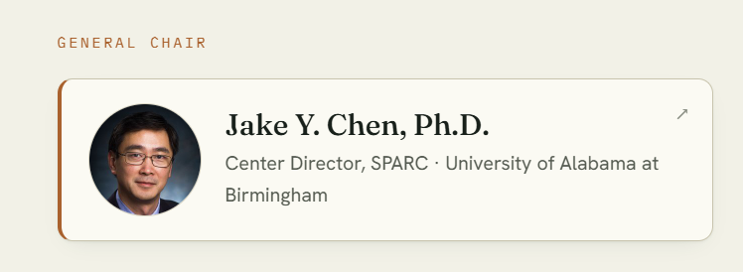
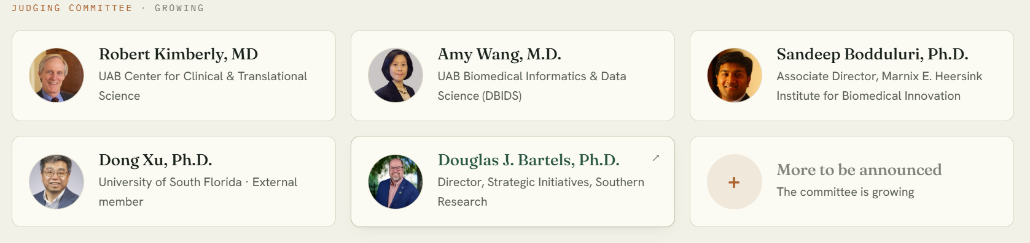
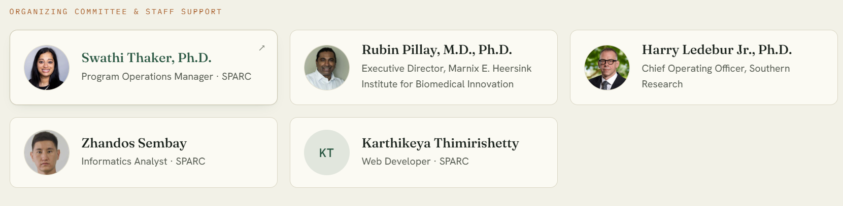
Organizers

